Slide 1
Arduino Workshop #6
The I²C bus

Slide 2
PowerPoint and Code
Github.com/EELabMan
Go To Repositories and find Arduino 6 I2C bus

Slide 3
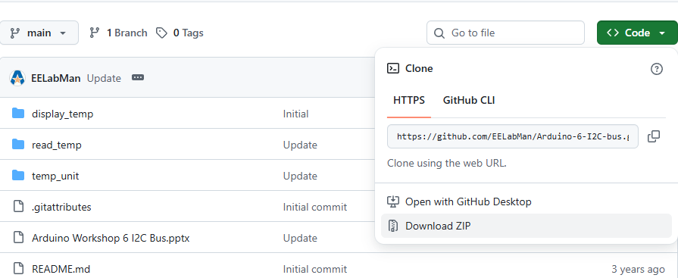
PowerPoint and Code
Click the GREEN code button and download the ZIP folder. BE SURE TO UNZIP THIS FOLDER.

Slide 4
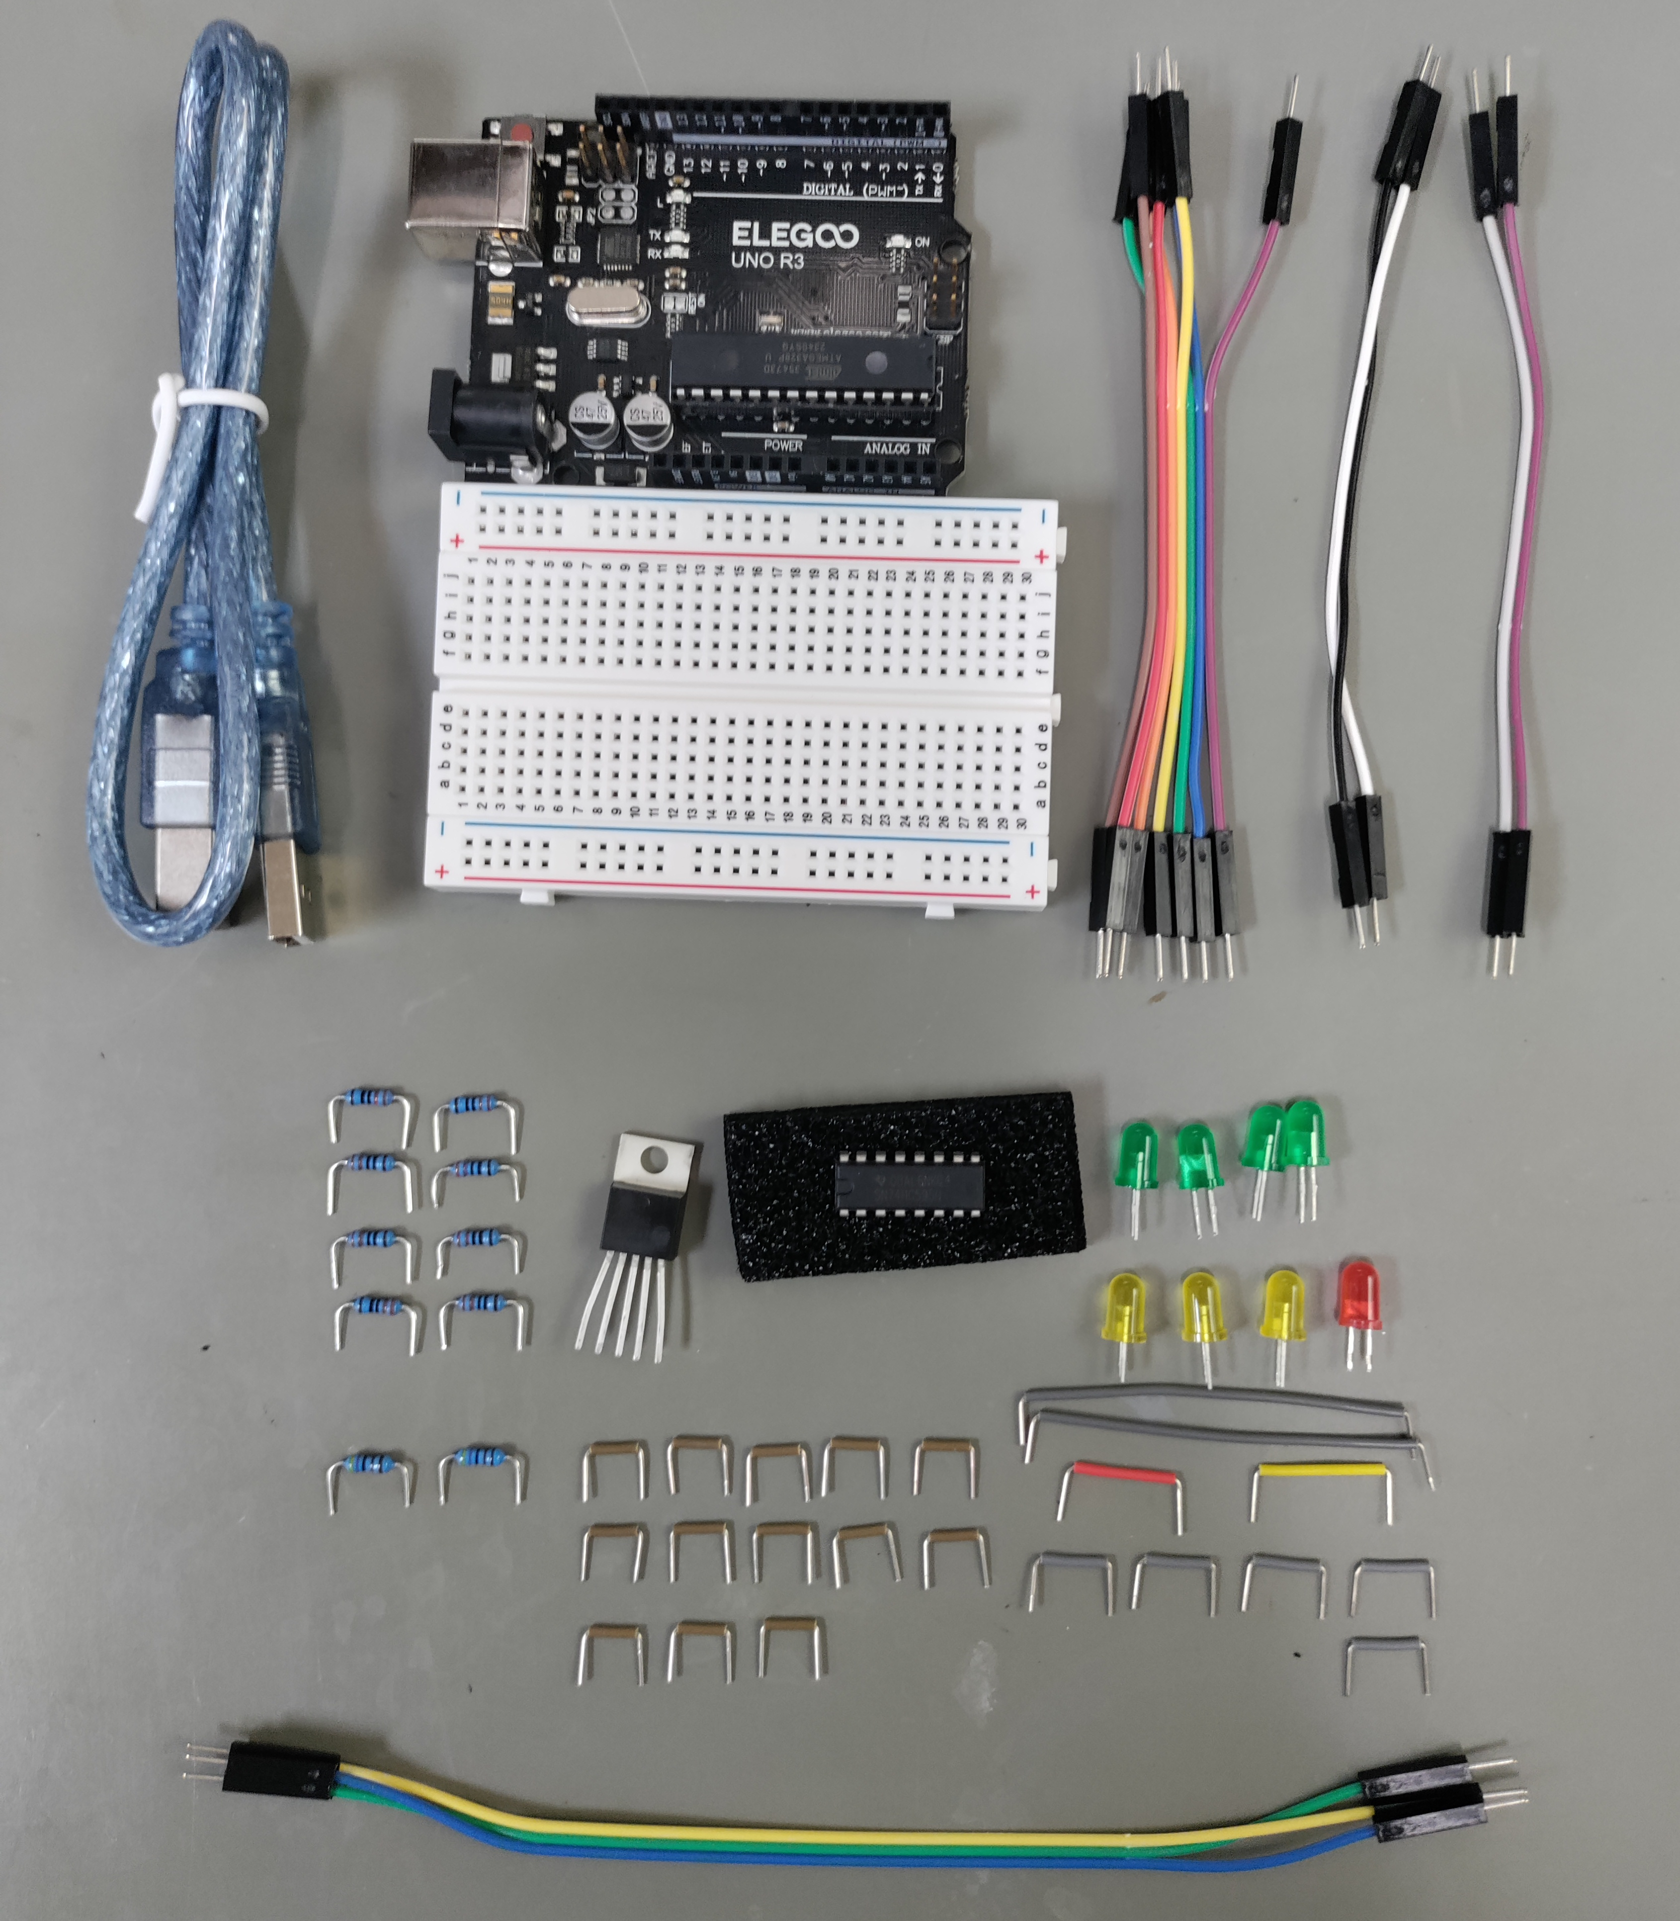
Parts
UNO
USB Cable
11, (7+2+2) short jumpers
Breadboard
4 Green LED’s
8 – 220Ω Resistors
3 yellow / 1 red LED
2 – 4.7kΩ Resistors
2 grey long BB wires
13 – brown (10mm) BB wires
1 red / 1 yellow BB wires
5 grey BB wires
3 – long male to male jumpers

Slide 5
Standardizing Integrated Circuits
We will look at the common I²C protocol
Pronounced “eye squared see” or “eye two see”
Invented in the 1980’s by Philips
Allowed relatively low speed communications for various IC’s
Standardized in the 90’s
Other companies adopted and released compatible chips
Generally known as “two wire”
Because two wires lines are used for communications
Data and a clock
I²C is a trademarked name
Think Kleenex vs Tissues
If an electronic item says “two wire compatible” it will be fairly certain to be I²C compatible

Slide 6
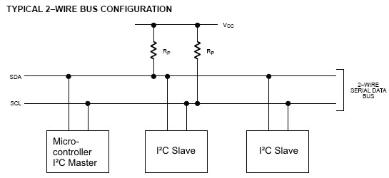
I²C Hardware Design
I²C is unique in that it can handle multiple devices
All share the same communication lines
A clock signal (SCL)
Bidirectional data line
Used to send data back and forth between the master and slave (SDA)
Notice that the I²C bus requires pull-up resistors on both data lines

Slide 7
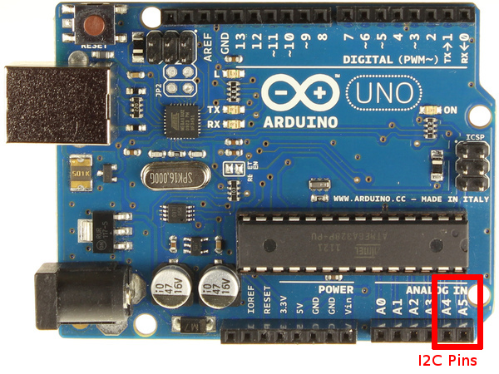
Hardware and pull up resistors
The value of the needed pull up resistors
Depends on the slave devices
Number attached and individual needs
Specified on Data sheet
4.7 ㏀ is fairly standard (and what we will be using)
ADC pins A4 and A5 can be changed through software to become Serial Data ( A4 ) and Serial Clock ( A5 ) for the I2C bus.

Slide 8
Communication Scheme and ID numbers
I²C can have multiple devices to share communication lines with a single “master” device
The Arduino will act as the master device
Responsible for initiating all communications
Slave devices can not initiate communication only respond to requests from the master
If not -- the communication line would be overwhelmed and data would drop

Slide 9
Naming and communication
Each slave device has a unique 7-bit address (ID)
Some I²C devices have selectable addresses
Some I²C devices have a fixed address (from the factory)
Temperature sensors are commonly preprogrammed with various IDs (to facilitate more than 1 sensor on a single bus)
When communication is initiated
An ID is transmitted
The slave device reacts to data on the bus only when it’s directed at their ID

Slide 10
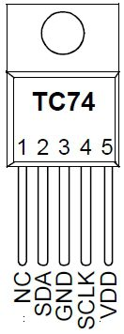
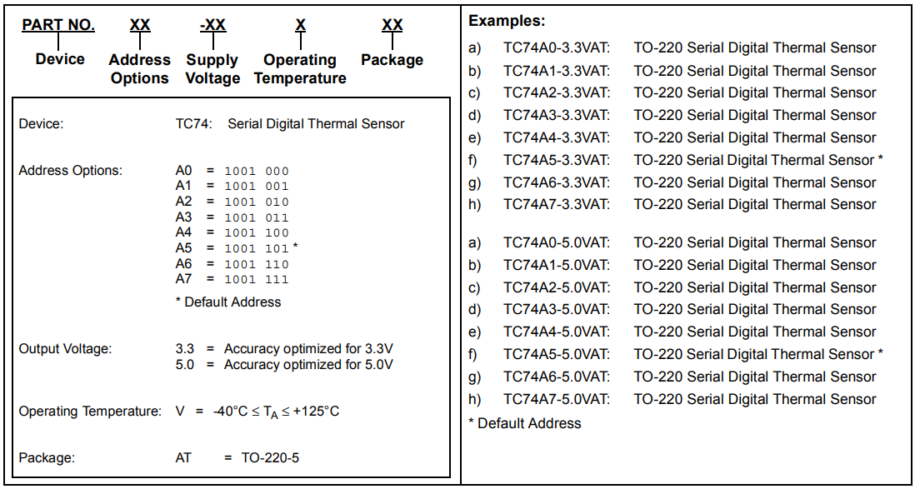
TC74 temperature sensor

Slide 11
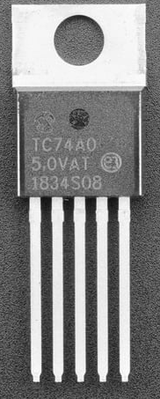
Things to notice from the Data sheet
Notice from this manufacture
This Sensor comes in 3.3 volts or 5 volts. Arduino works off of 5V logic, so we must use the 5V version.
You can purchase eight different ID numbers ( A0 – A7 )
You could put 8 of them on one I²C bus and read them independently
As you are writing the program to interface w/ your temp sensor later… be aware of its ID
Does your KIT have a TC74 - A0, A1,…A7 ?
Refer to the binary code on the previous slide, you will need it for your program to work!

Slide 12
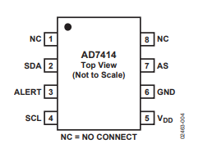
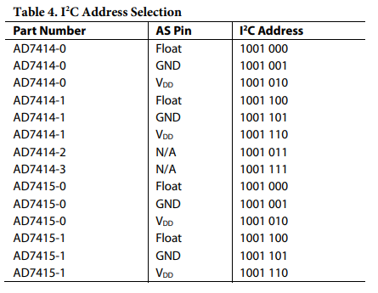
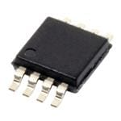
Address selectable I²C devices
Some chips (AD7414 and AD 7415) have address select (AS) pins
Allows you to configure the address of the device
Below we see AD7414 has an “AS” pin with 3 possible ID numbers
Depending on whether “AS” pin is left disconnected, is tied to VCC, or grounded
Board Mount Temperature Sensors SMBus / 12C 10-bit digital temp sensor I.C.

Slide 13
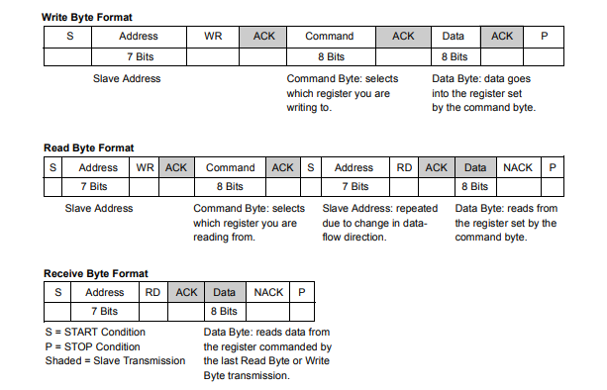
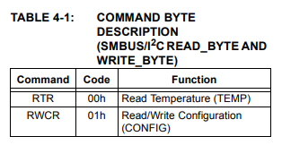
Before you can code an I²C device
You need to know the communication scheme
You need to know how to read the datasheet to determine this
Using what you already know about how I²C works
Notes:
Steps vary for different chips (with different requirements for different devices)
Thankfully Arduino I²C library can be used to abstract away most of the difficult timing work
Basic steps though are:
Master sends a start bit
Master sends 7-bit slave address of device it wants to talk to
Master sends read (1) or write (0) bit
Depending on the desired action
Slave responds with an “acknowledge” or ACK bit (a logic low)
Data is handled
In write mode
Master sends 1 byte of info at a time
Slave responds ACK
In Read mode
Master receives 1 byte of info at a time
Responds to slave with ACK

Slide 14
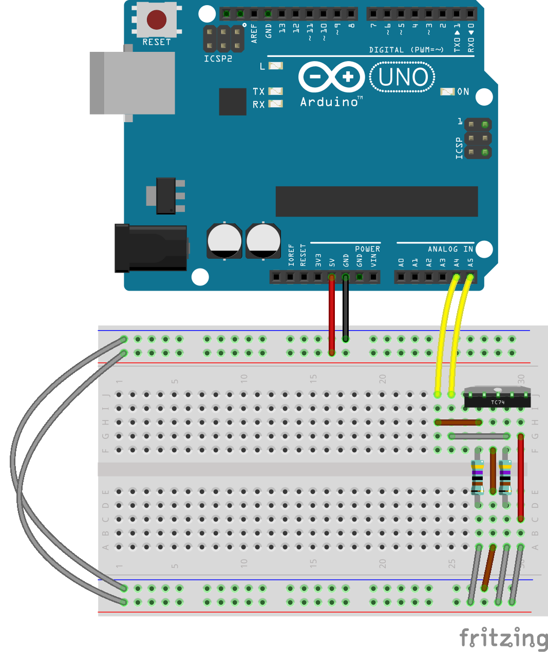
Wire it up
Resistors are 4.7K Ω
TC74 metal tab faces Arduino so Pin 1 is on the left

Slide 15
Things to note
You can use the serial to print out temps
It’s a digital signal
no conversion needed to see the data as a degree Celsius reading
SDA and SCL are wired to pins a4 and a5
They carry data and clock signal
Recall A4 and A5 are multiplexed pins
Between ADC and hardware I²C
When you initialize the wire library. Those pins connect to the ATMega’s I²C controller. Enabling with the Wire object to I²C device via those pins

Slide 16
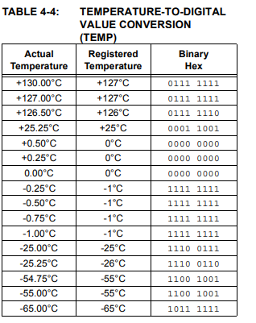
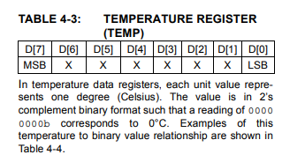
Tempurature data type 2’s compliment
You can both read and write to this I²C
As shown in the first table
The TC74 has 2 registers
Current temp (in ⁰C)
Contains configurable info about the chip (inc. standby state and data ready state)
In order to read the temp we can look at table 4-3 and 4-4
Notes:
2’s compliment - We need to base the code as an 8 bit 2’s compliment integer to read the sensor correctly.

Slide 17
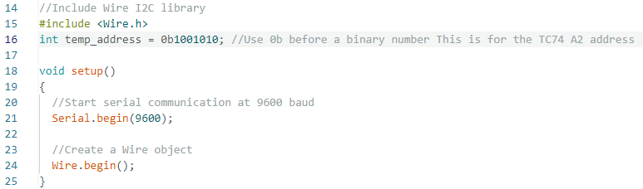
Upload the read_temp.ino
To include the I2C library, we just add the #included <wire.h> line
We then have to define the address of the I2C sensor. This one is set for the A2 version.
Just like the Serial.begin(9600) function in setup, we also have a Wire.begin() function.

Slide 18
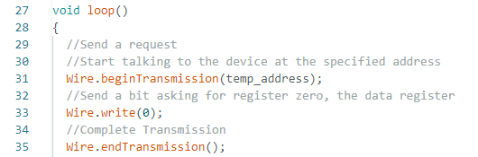
Main Loop
In the Main loop, Wire.beginTransmission(temp_address) will have the microcontroller ask that particular address to acknowledge it exist.
Wire.write sends a logic 0 to ask for the data in the register
The Wire.endTransmission() function tells the sensor that it can transmitter after it receives this command.

Slide 19
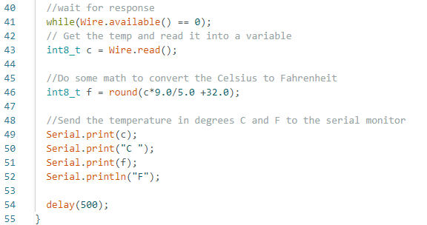
Main Loop cont.
while (Wire.available() ==0) will wait for the response from the sensor.
int8_t defines an 8-bit signed integer named “c” for Celsius. This is set equal to whatever the sensor data was read.
Converted to f ( Fahrenheit ): labels and data sent to the serial monitor.

Slide 20
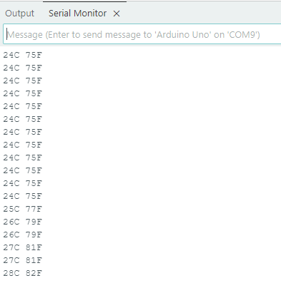
What you should see in the Serial Monitor
Squeeze the TC74 chip with your fingers to see the temperature rise.
Notes:
Get the circuit chiller to test the negative numbers.

Slide 21
Temp monitoring system

Slide 22
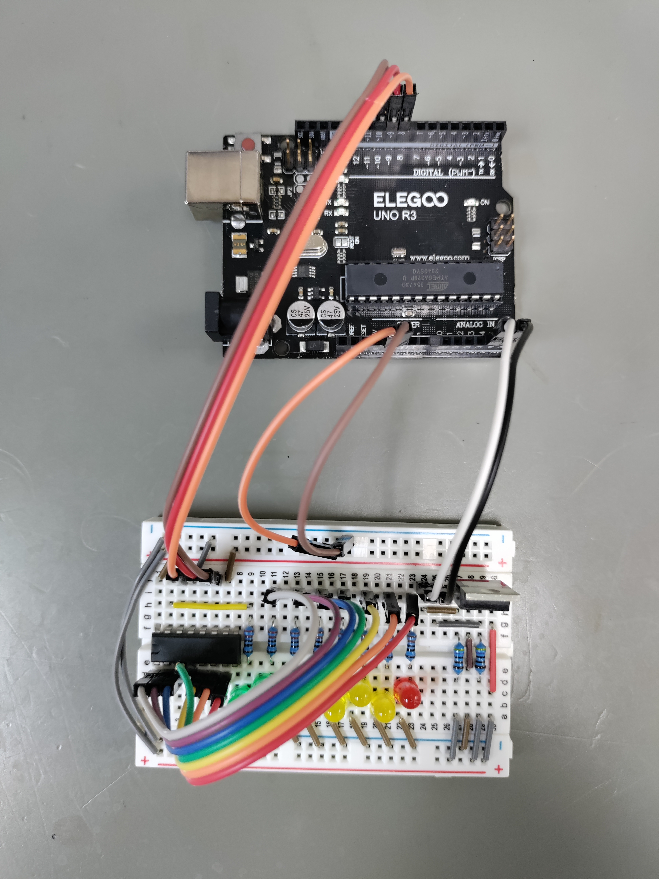
Physical Layout
You can use the 7 short jumpers to connect pins 1-7 to the LED resistors quickly and neatly.
The breadboard layout is on the next slide.

Slide 23
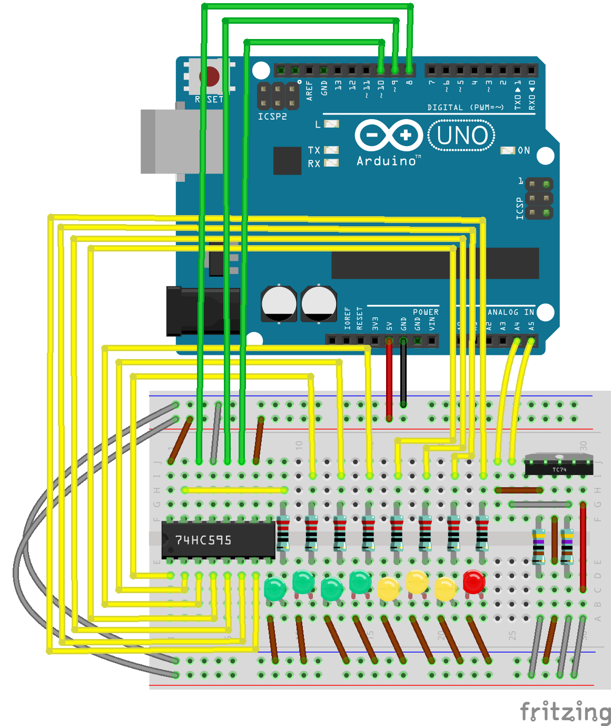
Wire the arduino
You can use the 7 short jumpers to connect pins 1-7 to the LED resistors quickly and neatly.
LED Cathode is on the left.

Slide 24
Minor modification of previous program
The print statements should read
Serial.print(c);
Serial.print(“C,”);
Serial.print(f);
Serial.print(“F.”);
This allows you to easily parse the temps by the delimiting character (“,” and “.” respectively)
Next we need to add a shift register code (from last session)and make the LEDs to the appropriate levels (the code given chose 24⁰C to 31⁰C but you can choose any level that works best for the room)

Slide 25
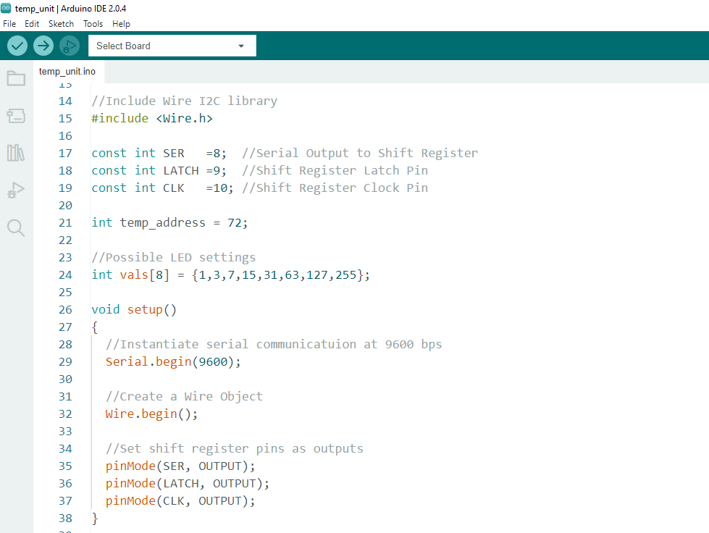
Upload temp_unit.ino to the Arduino
There is nothing new in the code. Please look it over so you have an idea on how it works.
Notes:
Click to open file

Slide 26
You should see
The LEDs light up and if you squeeze the temp sensor with your fingers making the temp go up.

Slide 27
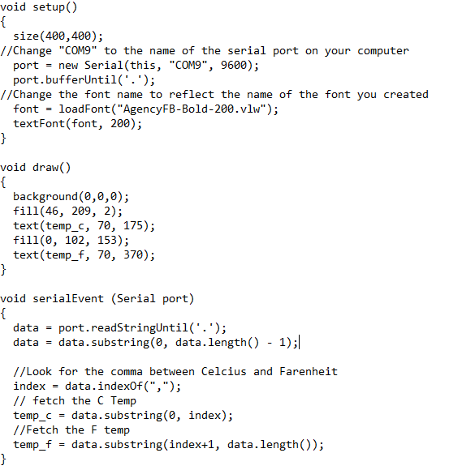
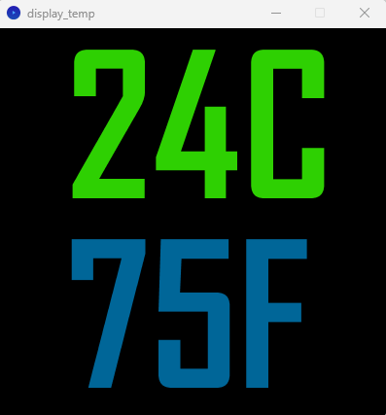
Open Processing and run the display temp sketch
Things to change
The com port needs to match the computer
Pick a font you enjoy
Pick a font size that you want
Arduino Serial Monitor must be closed

Slide 28
Clean up
Disassemble your breadboard and put all parts back in the bag for the next student.
Return the kit to the lab manager.

Slide 29
Stay tuned
Arduino 7 will cover the SPI bus.
We’ll wire two Digital Potentiometers!

